Slide 1
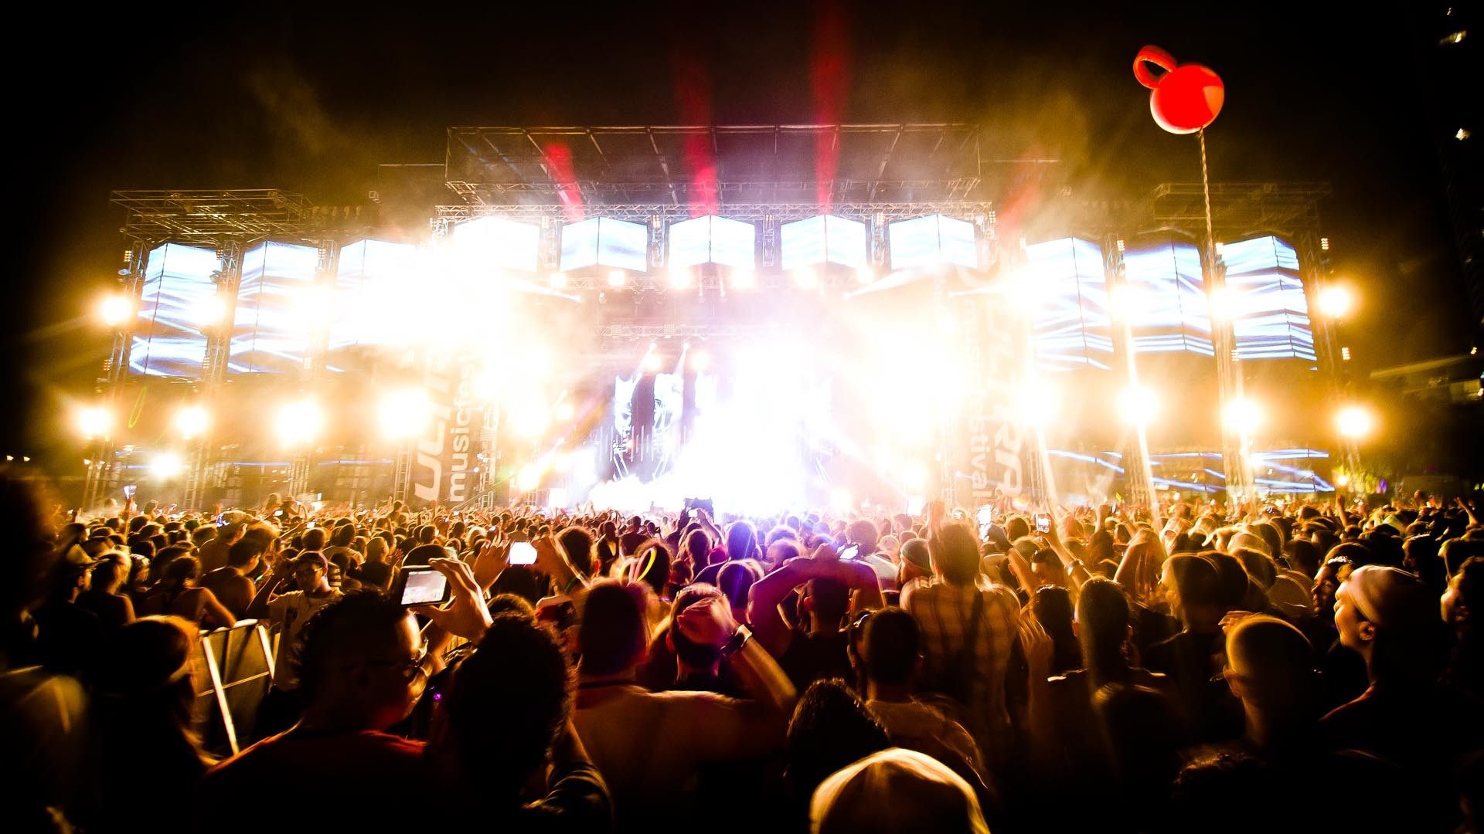
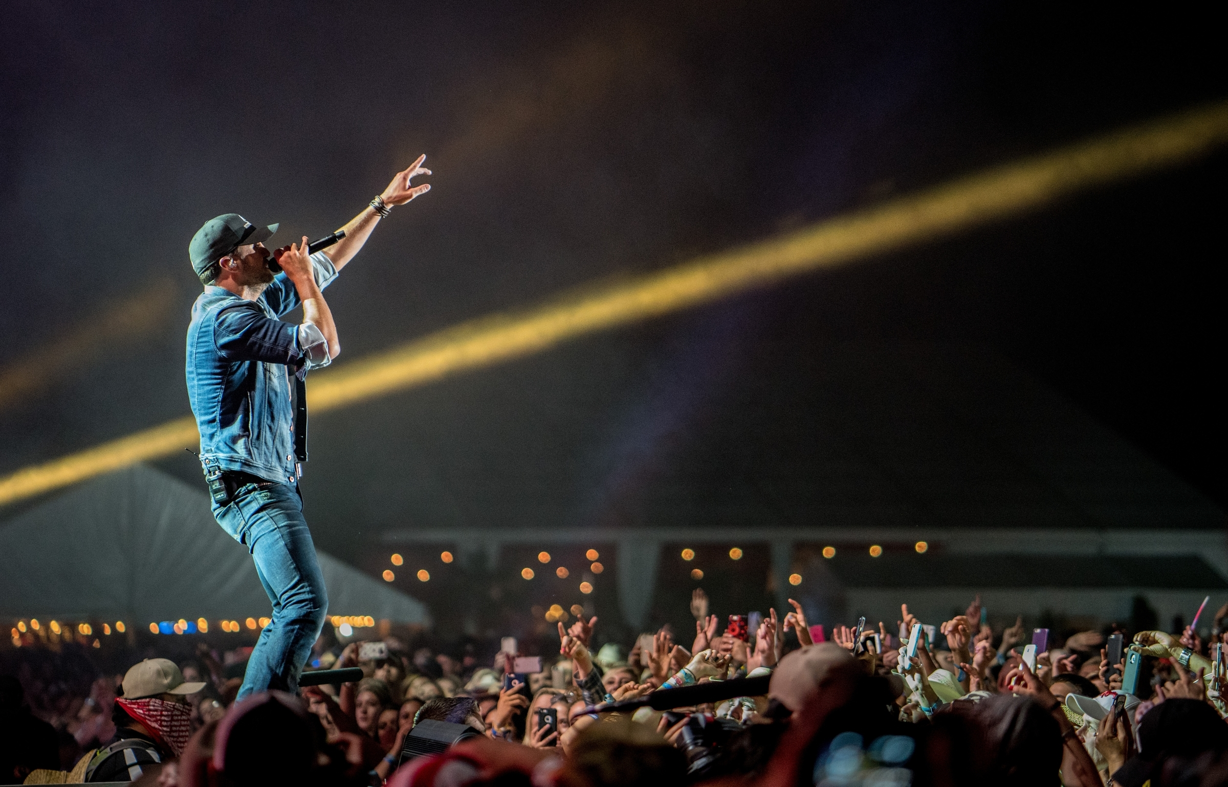
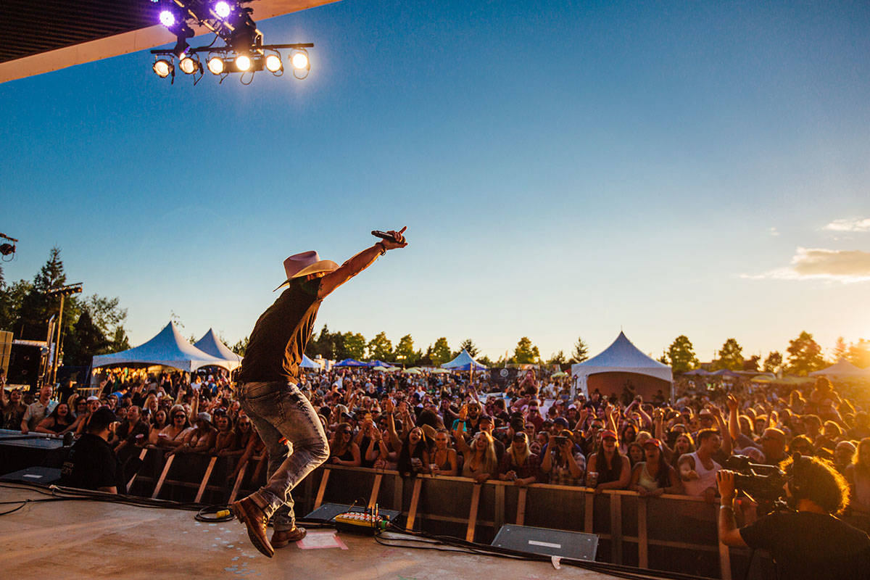
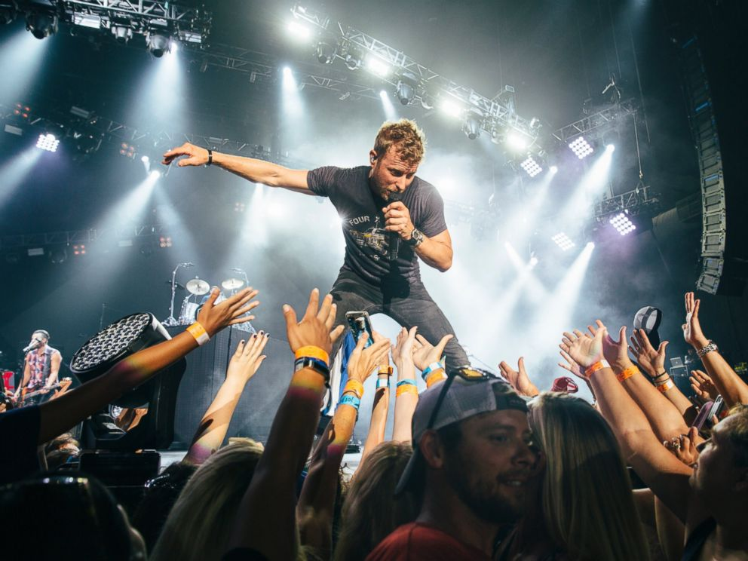

Slide 2

How do you calculate
how many people will come to the concert?
Before we sell tickets
So we can prepare the size of the field, the number of seats, and the number of tickets.

Slide 3
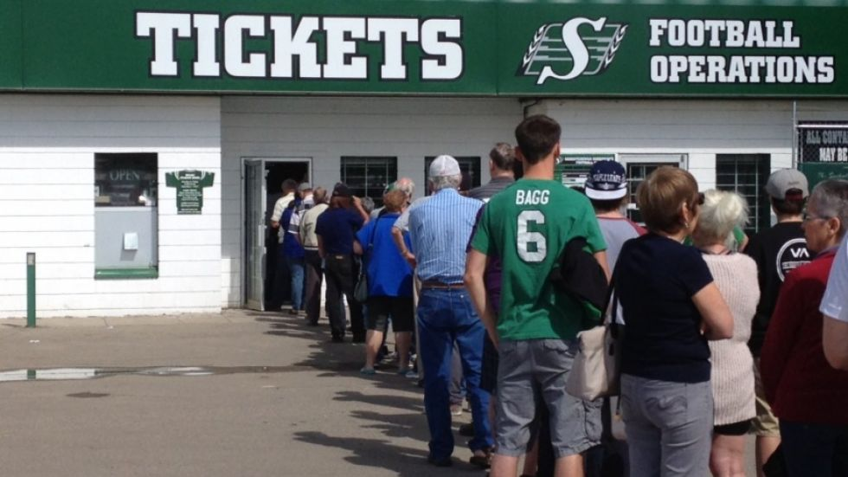
So we need to predict
the number of consumers
But HOW?

Slide 4
To minimize the problem
We can assume that
Consumers come from one city
The concert is held in that city
The price of each ticket is same
The number of people live in this city is constant

Slide 5
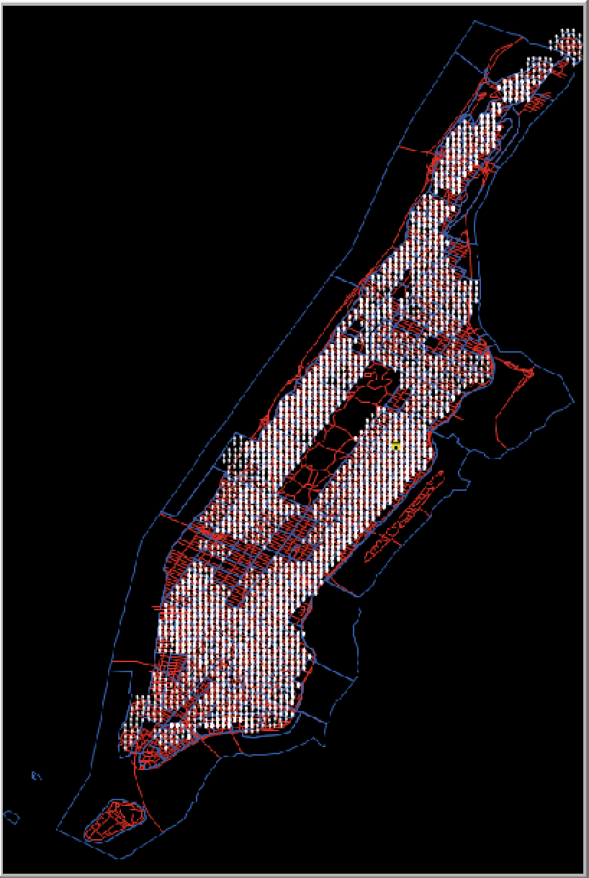
That’s not enough
But we can build a mathematical modeling and using Netlogo to show the environment geographically.

Slide 6

: people
: Road
: concert

Slide 7
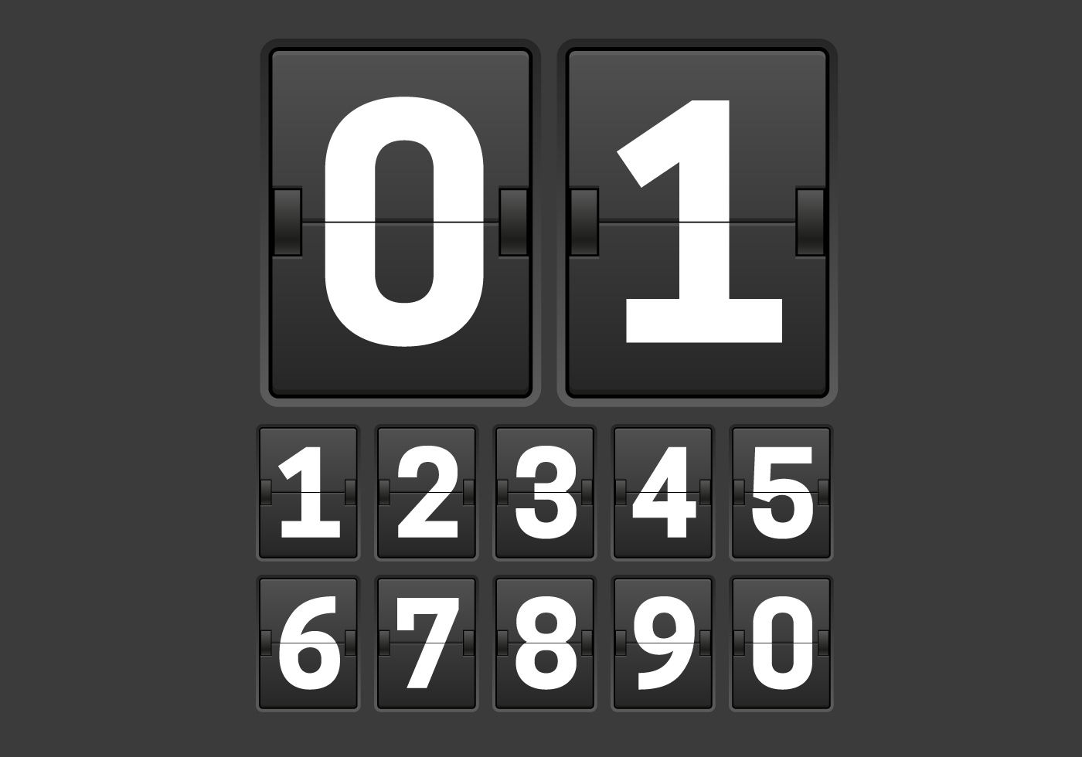
What causes people
to buy tickets?
How many weeks until the event occurs.

Slide 8
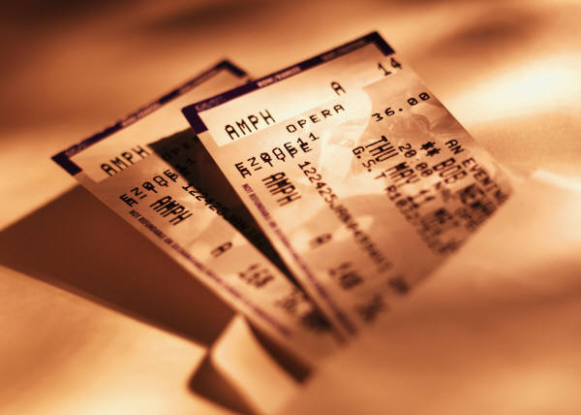
What causes people
to buy tickets?
what value the consumers expect to get out of attending the event.

Slide 9
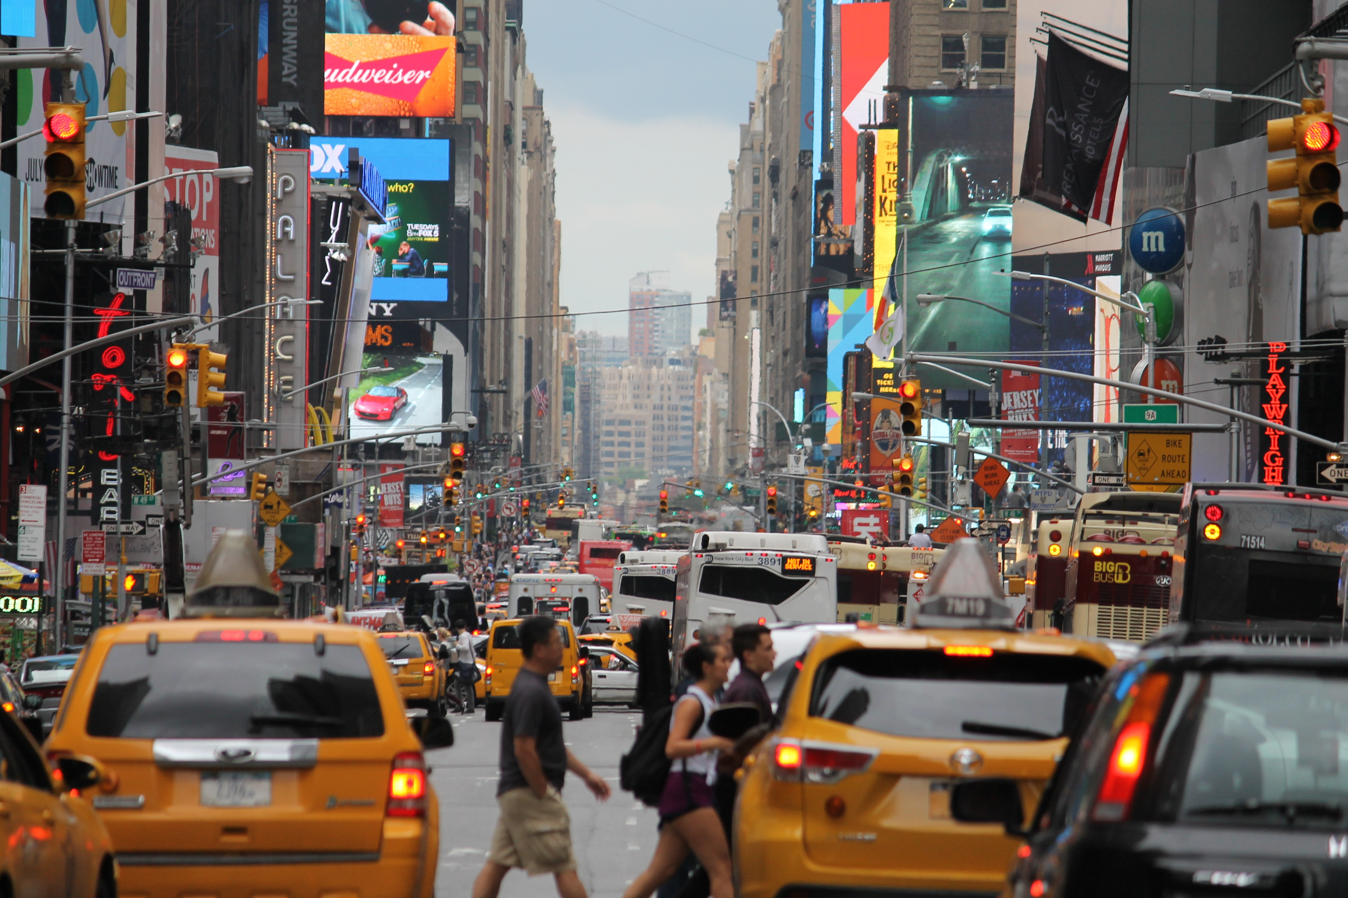
What causes people
to buy tickets?
how sensitive consumers are about the distance they are from the event.

Slide 10
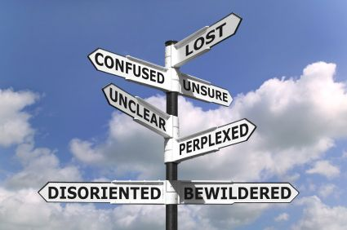
What causes people
to buy tickets?
how uncertain the consumers are in the quality of the event.

Slide 11
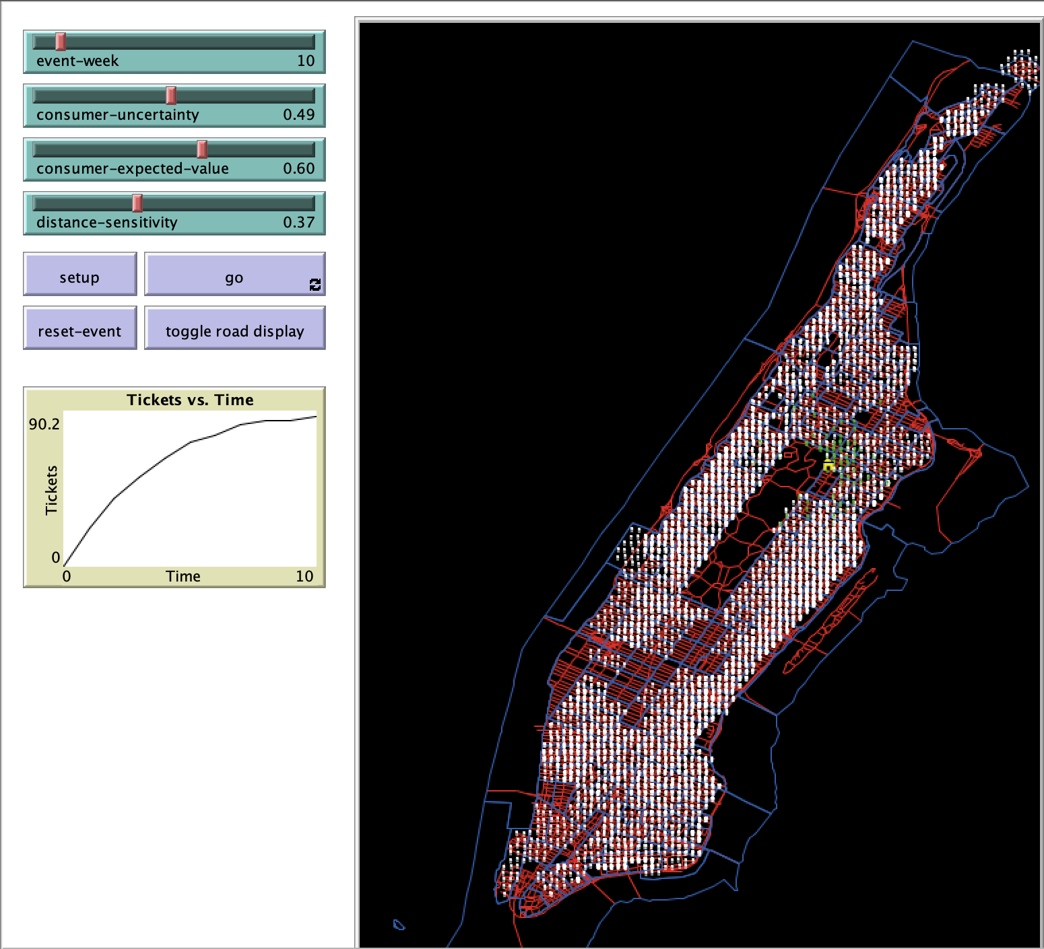
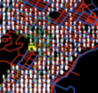
First
Try

Slide 12
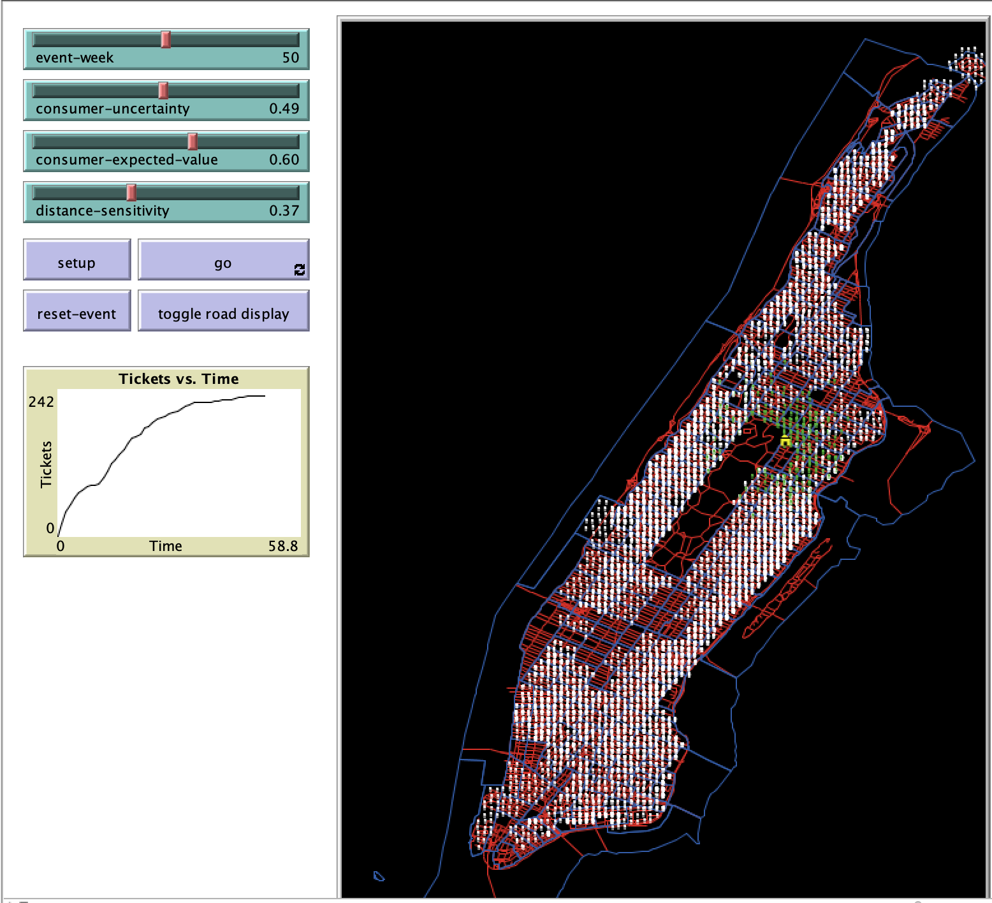
+40
days

Slide 13
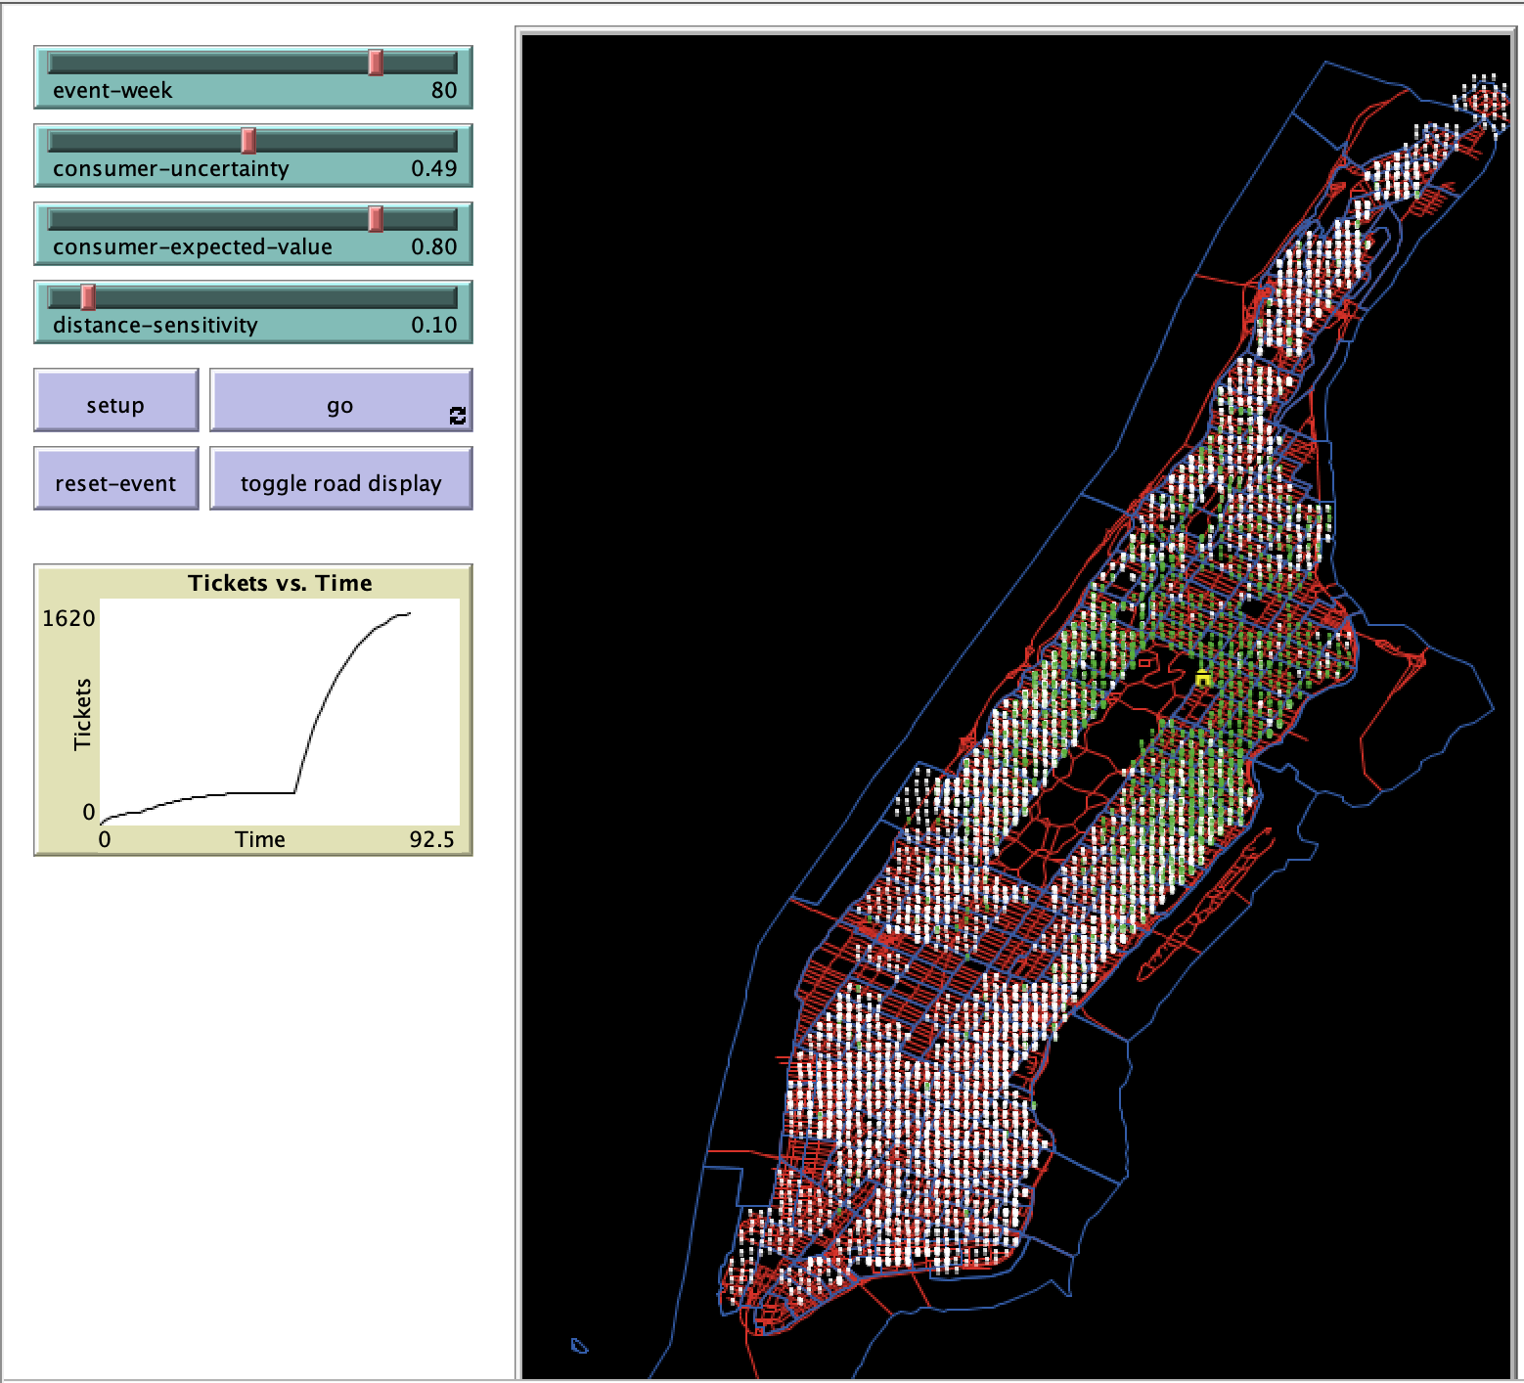
++30
days
and
.
.
.
.

